Slide 1
Bubblegum Mystery
By: Gr. 6/7
Important Note:
If you can see this box, then the slide show is not playing and the reveal won’t work.
Here is the solution:
If you are using PowerPoint, click on Slide Show, then click on From Current Slide.
Steve Wyborney
www.stevewyborney.com

Slide 2
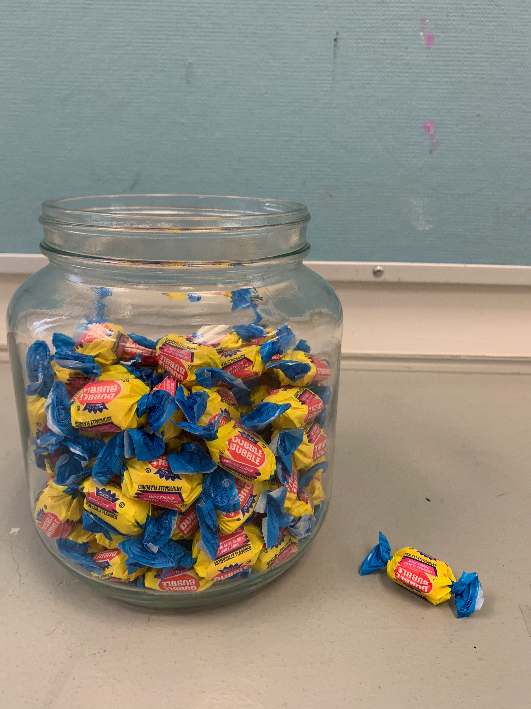
How many pieces of gum?
As the clues appear, use the information to narrow the possibilities to a smaller set.
Write down your first estimate. After each clue, you’ll see if your estimate is still a possibility. After each clue, if it is no longer possible write down a new estimate – and be prepared to explain why you chose it.

Slide 3
Clue #1
The number is even
Clue #1
Clue #2
Clue #2
There is no 0 in the number
Clue #3
Clue #3
The number is higher than 50
Clue #4
Clue #4
The number is not a multiple of 4
Clue #5
Clue #5
The difference between the two digits is 5
Steve Wyborney
www.stevewyborney.com

Slide 4
After seeing the clues, you have narrowed the possibilities to a small set of numbers.
Before you see the answer, select your final estimate.
Write it down,and explain to someone why you chose that number.
Steve Wyborney
www.stevewyborney.com

Slide 5
94 pieces of gum
The Reveal
Click to see the answer.
Important Note:
If you can see this box, then the slide show is not playing and the reveal won’t work.
Here is the solution:
If you are using PowerPoint, click on Slide Show, then click on From Current Slide.
Steve Wyborney
www.stevewyborney.com

